Slide 1
RNNDBSCAN implementation
Adam Traub

Slide 2
General Findings
DBSCAN is a generally fast and very effective in most cases
As the number of features grows, the time required to run the algorithm grows significantly
In an attempt to reduce run time, I generated a distance matrix for all values that could be used for generating KNN and RNN. All KNN and RNN values for a given k were generated ahead of time.
As predicted, the Grid dataset performed exceptionally poorly. The ctg dataset also performed poorly, but this may be due to a failure with pre-processing.

Slide 3
Running the code is straightforward
python RNNDBSCAN.py filename
Optional arguments: -k allows the user to specify how many k values to run (default 10). The starting and stopping points are based on the number of classes. - -verbose print out additional data with lots of time measurements (Recommended!)
- -help will give you a listing of the options.

Slide 4
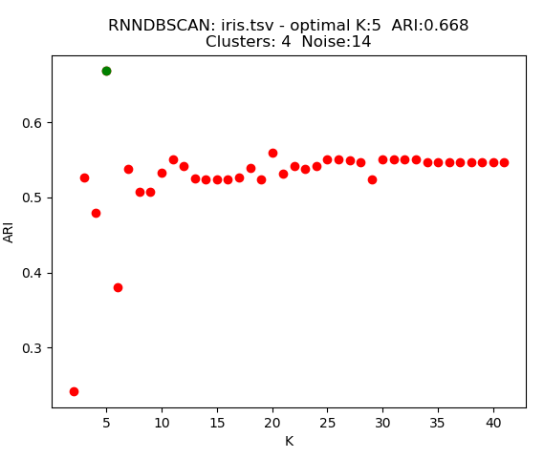
iris
ARI was consistent with paper with a difference in value of .024. Clusters were identical and this implementation had 2 fewer instances of noise.

Slide 5
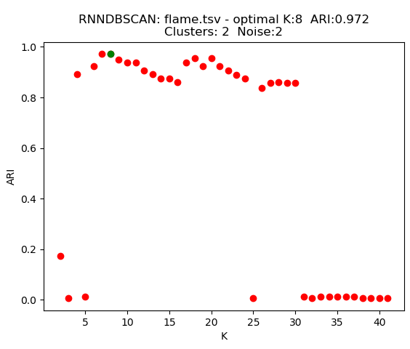
Flame
ARI was very consistent with paper showing a difference of .001, which may well be a rounding difference. Noise and Cluster counts were also identical.

Slide 6
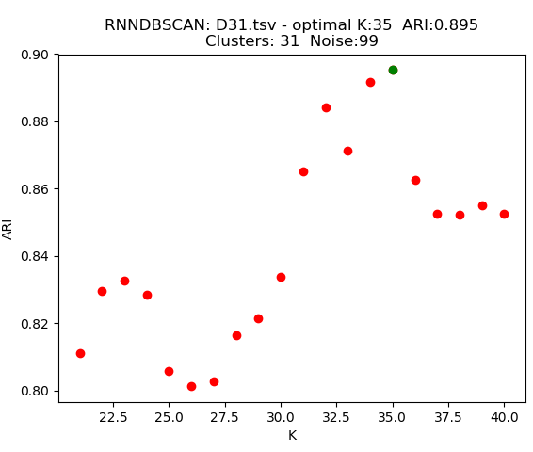
D31
ARI was very consistent with paper showing a difference of .001, which may well be a rounding difference. Both had 31 clusters, although this implementation had less noise.

Slide 7
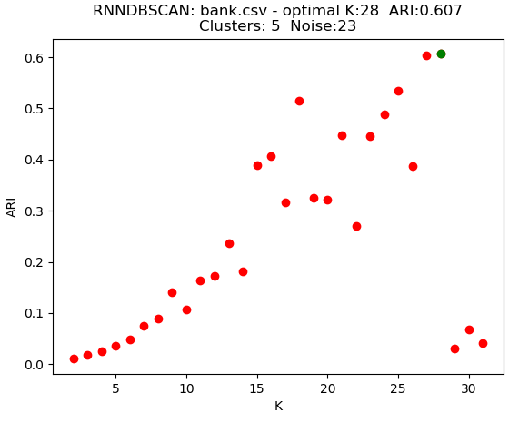
Bank
ARI was less consistent with paper with a difference of 0.164. Clusters and noise were also very different from paper.

Slide 8
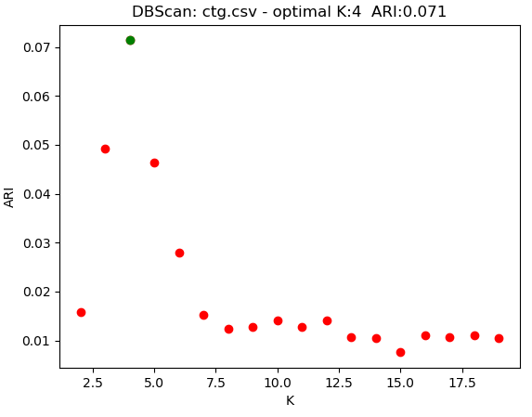
Ctg
RNN
The paper mentioned that CTG had 19 features, but mine had anywhere from 20-22 depending on which portion of the dataset I used. I need to examine this further.
Run-time with 22 features was approx. 4.73 hours on my Desktop PC. Results inconsistent with paper

Slide 9
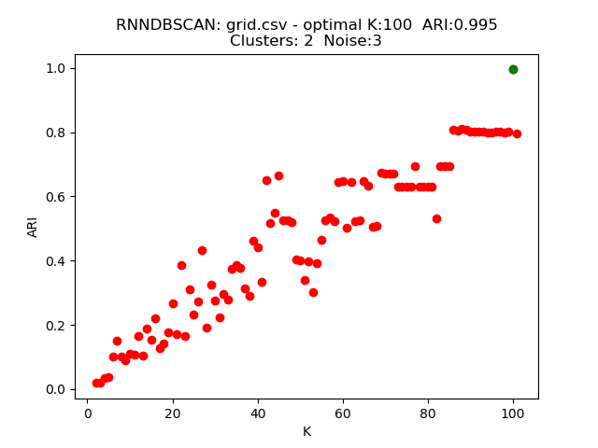
Grid
ARI, Clusters, and Noise were all reasonably close to the paper - although I had to run with very high k-values in order to achieve that.

Slide 10
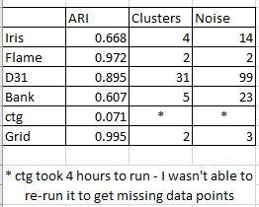
Next
Steps
The immediate next step is a purity measure.
Given more time, I think it would be worthwhile to rewrite the code so that multiple DBScan’s can be ran in parallel from the same pre-processed data. it might even be possible to parallelize portions of the DBSCAN algorithm itself, but much more research would be required. It would be an interesting project to attempt implementing DBSCAN with a newer high-level language that better emphasizes speed and concurrency, such as GoLang or Rust.

